Slide 1
Developing Ethical Systems in Technology-Focused Organizations
Policy and Compliance
Metrics and Monitoring
Communication and Stakeholder Engagement
Ethical Leadership

Slide 2
Policy and Compliance
Topic A

Slide 3
What Are Policy and Compliance?
Policy: The rules imposed by external authorities, the internal legal design of the organization, and rules governing conduct within that structure.
Compliance: The process of enforcing and abiding by policies.
Internal bylaws and operating structures
Internal rules of conduct
External regulations

Slide 4
Why Do Policy and Compliance Matter?
Type | Example
External regulations affect organizational ethics and can be influenced by organizations. | Net neutrality
Internal structures, such as choice of organizational form, shape incentives. | OpenAI’s hybrid nonprofit/for-profit structure
Rules of conduct help to balance conflicting values, such as privacy and scientific progress. | 23andMe’s privacy policy

Slide 5
Internal Structures and Systems
Internal governance and management structures
Define and distribute power.
Shape incentives for behavior.
A common source of ethical success and failure.
Example: labor disputes at Amazon.
Standard operating procedures (SOPs)
Should be clear, consistent, and fair.
Can promote efficiency, limit arbitrary decisions, and curb abuses of power.

Slide 6
Policy Tools for Emerging Technologies
Codes of conduct (e.g., ACM code of ethics)
Product policies on sales and use (e.g., Salesforce Acceptable Use Policy)
Ethics review boards (e.g., Facebook Oversight Board)
Chief Ethics Officer
Cross-functional ethics committees
Ethics hotlines and complaint reporting

Slide 7
Compliance, Enforcement, and Contestation
Successful policies require compliance and monitoring.
Enforcement of policies is delicate, requiring sensitivity to equity and due process.
Successful policies require opportunities for dispute and contestation.
Organizations should protest or withhold compliance from regulations they find unconscionable, but this requires careful and strong justification.

Slide 8
Internal Policy Design Process
Identify the need for the policy.
Identify the owner(s) of the policy.
Gather information about the policy.
Consult appropriate stakeholders.
Draft the policy and invite further comments.
Establish procedures for implementation, monitoring, and dispute resolution.
Approve the policy.
Publish the policy and determine best means of communication.
Implement the policy and monitor results.
Review and revise the policy at regular intervals.

Slide 9
Activity: Discussing Policy and Compliance
Scenario: Consider the RudiBrace product, or a product at your workplace.
Outline the basic elements of an internal or external acceptable use policy for RudiBrace.
What constraints (if any) should RudiBrace place on how corporate customers use the RudiBrace product?
Why did you answer the way you did?

Slide 10
Metrics and Monitoring
Topic B

Slide 11

What Gets Measured Gets Done
Organizations developing emerging technology companies bank heavily on metrics.
These companies tend to be less hierarchical, and product teams have more freedom to self-organize.
Most of the knowledge about execution lies with engineering staff and other individual contributors.
Steering by metrics allows product teams to experiment.

Slide 12
From Metrics to Monitoring
Metrics are not neutral.
Metrics are rarely sufficient.
Metrics can crowd out ethical behavor.

Slide 13

Measuring Organizational Culture
An ethics culture survey asks employees to rate:
How well their organization practices ethical decision-making.
Root causes of ethical and unethical decision-making.
Good culture surveys can provide insight into drivers of ethical and unethical behavior.
But there are limitations to a purely quantitative approach.
A comprehensive culture audit includes:
An ethical culture survey.
A review of organizational documents.
Interviews with key managers and employees.

Slide 14

Monitoring the Use of Foresight Tools
Metrics can also help ensure that teams go through the right process to surface and address ethical issues.
You may decide to track metrics like:
The number of potential ethical issues surfaced during product development.
The proportion that was addressed and mitigated before the product shipped.
Reviews of these metrics can be built into regular project reviews.
Create a space to talk about potential ethical issues.
Escalate any issues that the team cannot address by itself.

Slide 15

Monitoring the Impact on Society
There is a growing trend to use ESG metrics to measure your social contribution.
The biggest challenge for organizations is to design good metrics and monitoring tools, particularly to capture social and governamental challenges.
You can use the SDG Compass as a guide to align your strategy with the UN’s 2030 Agenda.

Slide 16
Activity: Discussing Metrics and Monitoring
Scenario: Consider the RudiBrace product, or a product from your workplace.
List two impacts on society that the organization should be conscious of. (There are no right or wrong answers.)
Come up with a creative metric to measure each of the impacts. (There are no right or wrong answers.)
For each metric, think about how single-minded pursuit of the metric might lead to negative side effects.

Slide 17
Communication and Stakeholder Engagement
Topic C

Slide 18
Why Do Communication and Engagement with Stakeholders Matter?
Stakeholders have crucial information/expertise to contribute to company policy or product design.
Engaging with stakeholders generates and maintains trust, which supports business success.
Stakeholders may often have a right to be informed or to have their voices heard.
Seeking stakeholder input can be an important sign of respect.

Slide 19

Identification of Relevant Stakeholders
To begin, you need to identify and understand different perspectives and interests.
If all interests cannot be realized simultaneously, organizations must prioritize stakeholders’ claims and be able to justify these decisions.
Ethical reasoning helps with weighing different claims.
Different stakeholders might take priority in different contexts, and who counts as a stakeholder might evolve over time.

Slide 20








Mechanisms for Engaging Stakeholders
Surveys and focus groups
Figures on sales, product usage, or marketing
Social media
Voting and representation mechanisms
Hotlines and customer service platforms
Working groups
Town hall meetings
Deliberative juries

Slide 21
Communication During and After a Crisis
Common sources of ethical crisis:
Leadership scandal
Data breach
Product malfunction or misuse
Employee misconduct
Guidelines for crisis communication include providing timely information on:
Source of the problem
Efforts underway to contain and investigate the problem
Plans for corrective, compensatory, or disciplinary action
Opportunities for affected individuals to voice questions or concerns
Updates on the progress of the resolution

Slide 22
Activity: Discussing Communication and Stakeholder Engagement
Scenario: Consider the RudiBrace product, or a product from your workplace.
How should the RudiBrace team engage with stakeholders before the product launch?
How should stakeholders be identified?
What considerations will the team need to weigh in cases of conflict?
How should the RudiBrace team engage with stakeholders after product launch?
How should stakeholders be identified?
What considerations will the team need to weigh in cases of conflict?

Slide 23
Ethical Leadership
Topic D

Slide 24



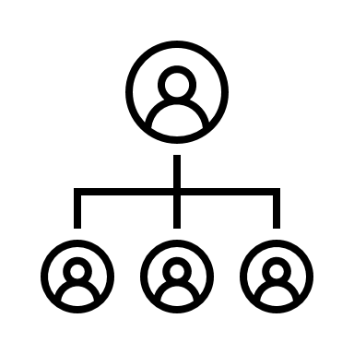




What Is Ethical Leadership?
Ethical leadership involves exercising influence to guide others in the ethical pursuit of aims.
Implementing new organizational forms, systems, and policies
Blending profit and purpose by design
Social missions
Democratic governance measures

Slide 25
Methods for Increasing Ethical Leadership
Implementing new organizational forms, systems, or policies.
Experimenting with new ways of blending profit and purpose by design.
Adopting social missions.
Placing constraints on profit-seeking.
Experimenting with methods of decentralizing authority.
Introducing democratic (not autocratic) governance measures into the workplace.
Starting businesses that are owned by employees themselves.
Experimenting with flat structures that reduce reliance on traditional hierarchies.

Slide 26
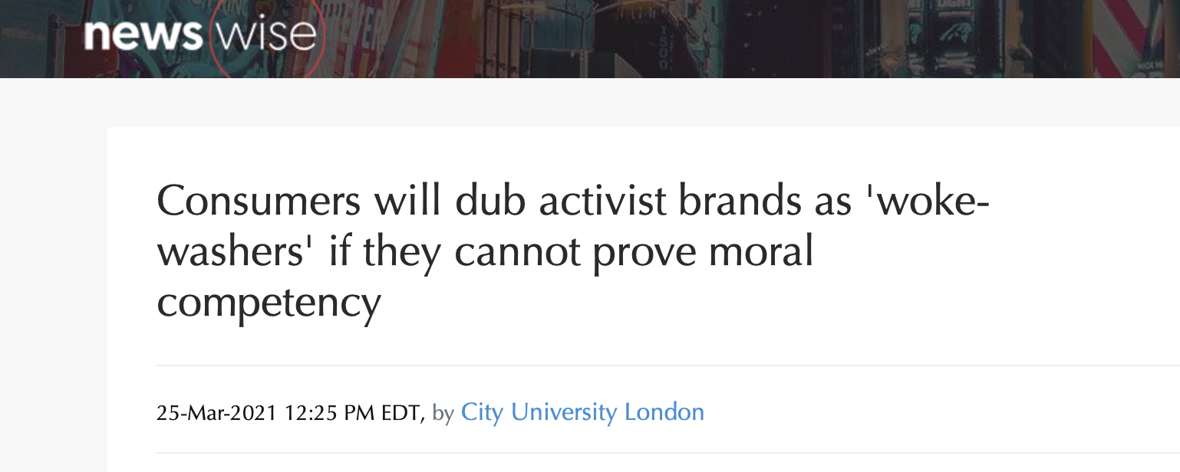

Corporate Social Responsibility and Taking a Stance
Corporate activism
Virtue signaling
Speaking out on social issues
Lack of representation
Using power for good
Disregarding minorities

Slide 27




Leadership through Standard Setting
"Being ethical" can be costly.
Standard Setting
Contact with national and international standard setting bodies.
Committees of independent technical experts.
Engagement with standard-setting efforts.
Common ethical purposes and commitments

Slide 28
Activity: Discussing Ethical Leadership
Scenario: General discussion. Think about your personal definition of ethical leadership, and consider the ethical challenges you have encountered throughout this course.
Do you think corporations should try to influence public policy outcomes?
Has public policy changed as a result of these influences?
Can you think of two or three items that you want to focus on at your workplace?
Do you think that technology organizations should influence policy?
How have your views on technical organizational ethics changed as a result of this course?

Slide 29
At your workplace, what suggestions might you make for adopting metrics and monitoring for ethical behaviors?
At your workplace, what suggestions might you make to strengthen the ethical leadership qualities of the organization?

